Slide 1
GOURAV SEMWAL
303960
Digital electronics [5th semester]
Presentation on PLC CONTROL PANEL
C.R.R.I.T.

Slide 2
Electricity meter
An electricity meter or energy meter is a device that measures the amount of electric energy consumed by a residence, business, or an electrically power device.
Electricity meter are of two types
1. Analog meter
2. Digital meter

Slide 3
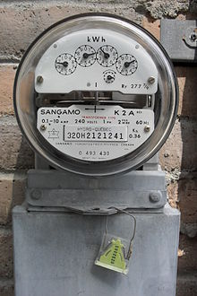
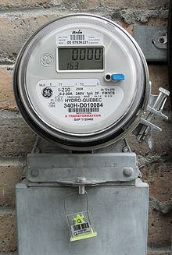
Electricity meters
Analog electricity meter Digital electricity meter

Slide 4
Direct current (DC)
Direct current (DC) is the unidirectional flow of electric charge. Direct current is produced by sources such as batteries, thermocouples, solar cells, and commentator-type electric machines of the dynamo type. Direct current may flow in a conductor such as a wire, but can also flow through semiconductors, insulators, or even through a vacuum as in electron or ion beams. The electric charge flows in a constant direction, distinguishing it from alternating current (AC). A term formerly used for direct current was galvanic current.

Slide 5
Alternating current (AC)
In alternating current (AC, also dc), the movement of electric charge periodically reverses direction. In direct current (DC, also ac), the flow of electric charge is only in one direction. AC is the form in which electric power is delivered to businesses and residences. The usual waveform of an AC power circuit is a sine wave. In certain applications, different waveforms are used, such as triangular or square waves. Audio and radio signals carried on electrical wires are also examples of alternating current. In these applications, an important goal is often the recovery of information encoded (or modulated) onto the AC signal.

Slide 6
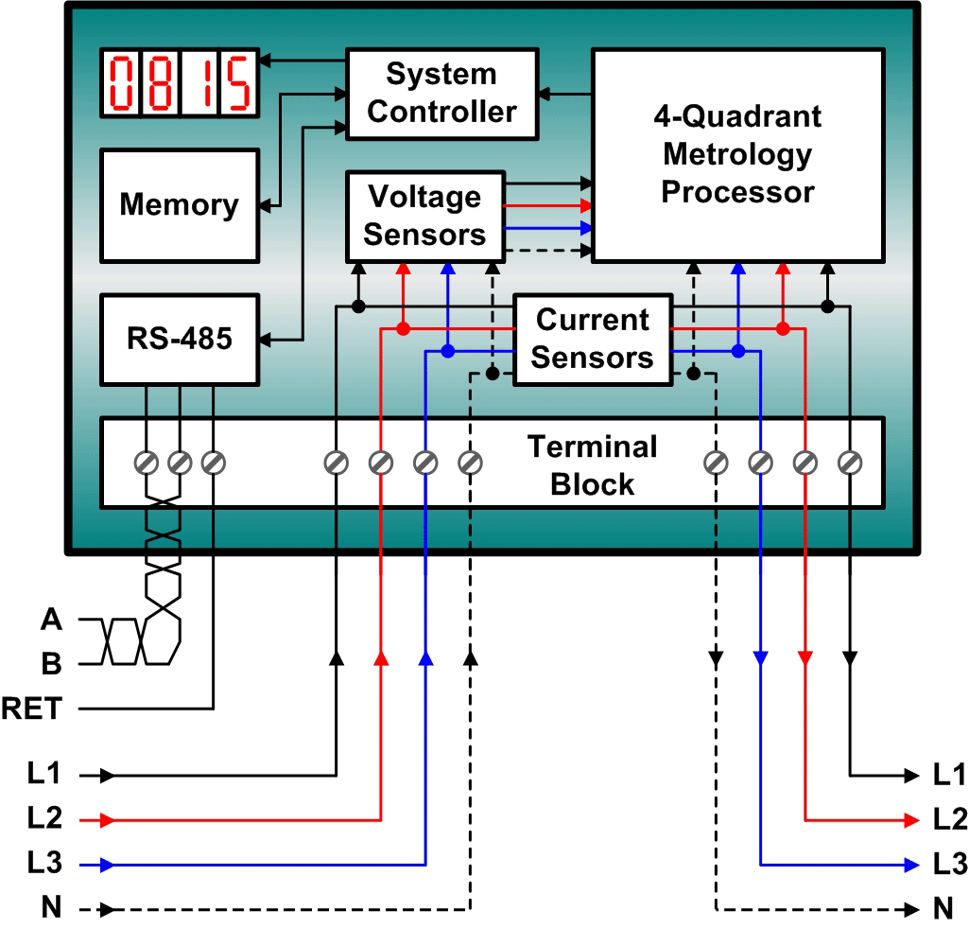
Block diagram of an electronic energy meter

Slide 7
Types of meters
Electricity meters operate by continuously measuring instantaneous voltage (volts) and current (amperes) and finding the product of these to give instantaneous electrical power (watts) which is then integrated against time to give energy used (joules), kilowatt-hours etc.). Meters for smaller services (such as small residential customers) can be connected directly in-line between source and customer. For larger loads, more than about 200 ampere of load, current transformers are used, so that the meter can be located other than in line with the service conductors. The meters fall into two basic categories, electromechanical and electronic.

Slide 8
Electromechanical meters
The most common type of electricity meter is the electromechanical induction watt-hour meter.
The electromechanical induction meter operates by counting the revolutions of an aluminum disc which is made to rotate at a speed proportional to the power. The number of revolutions is thus proportional to the energy usage. The voltage coil consumes a small and relatively constant amount of power, typically around 2 watts which is not registered on the meter. The current coil similarly consumes a small amount of power in proportion to the square of the current flowing through it, typically up to a couple of watts at full load, which is registered on the meter. The metallic disc is acted upon by two coils. One coil is connected in such a way that it produces a magnetic flux in proportion to the voltage and the other produces a magnetic flux in proportion to the current. The field of the voltage coil is delayed by 90 degrees using a lag coil. This produces eddy currents in the disc and the effect is such that a force is exerted on the disc in proportion to the product of the instantaneous current and voltage.
A permanent magnet exerts an opposing force proportional to the speed of rotation of the disc. The equilibrium between these two opposing forces results in the disc rotating at a speed proportional to the power being used. The disc drives a register mechanism which integrates the speed of the disc over time by counting revolutions, much like the odometer in a car, in order to render a measurement of the total energy used over a period of time.
The type of meter described above is used on a single-phase AC supply. Different phase configurations use additional voltage and current coils.

Slide 9
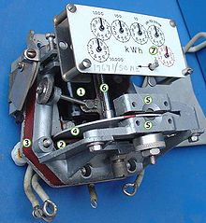
Electromechanical meter
Mechanism of electromechanical induction meter.
1 - Voltage coil - many turns of fine wire encased in plastic, connected in parallel with load.
2 - Current coil - three turns of thick wire, connected in series with load.
3 - Stator - concentrates and confines magnetic field.
4 - Aluminum rotor disc.
5 -rotor brake magnets.
6 - spindle with worm gear.
7 - display dials - note that the 1/10, 10 and 1000 dials rotate clockwise while the 1, 100 and 10000 dials rotate counter-clockwise

Slide 10
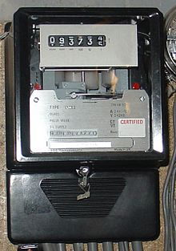
Electromechanical meter
Three-phase electromechanical induction meter, metering 100 A 230/400 V supply. Horizontal aluminum rotor disc is visible in center of meter

Slide 11
Solid-state design meters
The meter has a power supply, a metering engine, a processing and communication engine and other add-on modules such as RTC, LCD display, communication ports/modules and so on. The metering engine is given the voltage and current inputs and has a voltage reference, samplers and quantizes followed by an ADC section to yield the digitized equivalents of all the inputs. These inputs are then processed using a Digital Signal Processor to calculate the various metering parameters such as powers, energies etc.
The largest source of long-term errors in the meter is drift in the preamp, followed by the precision of the voltage reference. Both of these vary with temperature as well, and vary wildly because most meters are outdoors. Characterizing and compensating for these is a major part of meter design.
The processing and communication section has the responsibility of calculating the various derived quantities from the digital values generated by the metering engine. This also has the responsibility of communication using various protocols and interface with other add-on modules connected as slaves to it.
RTC and other add-on modules are attached as slaves to the processing and communication section for various input/output functions. On a modern meter most if not all of this will be implemented inside the microprocessor, such as the Real Time Clock (RTC), LCD controller, temperature sensor, memory and analog to digital converters.

Slide 12
Assembly of meter
Base
CT
Terminal
Screw/Block
Shot plate
CT wire
LED
LCD
PCB

Slide 13
Types of meter
5 -10 amp :-
10 – 40 amp :-
2.5 – 10 amp :-

Slide 14
Types of meter
5 -10 amp :-
240 volts, 5 amp current, UPF(unit power factor), PF(power factor)
Full load Imax :- 20 amp
Crip test :- No load
1 unit – 1 hour – 1000 watt – 3200 pulse

Slide 15
Types of meter
10 – 40 amp :-
240 volts, 10 amp current, UPF(unit power factor), PF(power factor)
Full load Imax :- 40 amp
Crip test :- No load
1 unit – 1 hour – 1000 watt – 1600 pulse

Slide 16
Types of meter
2.5 – 10 amp :-
240 volts, 2.5 amp current, UPF(unit power factor), PF(power factor)
Full load Imax :- 10 amp
Crip test :- No load
1 unit – 1 hour – 1000 watt – 6400 pulse

Slide 17
Accuracy adjustment of meters
current voltage UPF
5 – 20 amp – 100% 240 volt 1
10 – 40 amp – 100% 240 volt 0.50
2.5 – 10 amp – 100% 240 volt 0.80

Slide 18
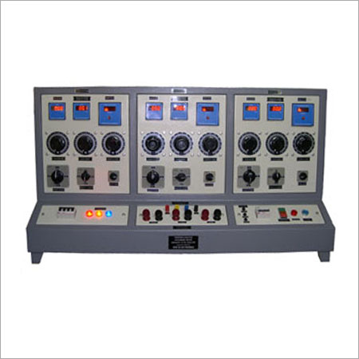
Phantom machine
It is used to give voltage as per required and passes the supply to radium machine

Slide 19
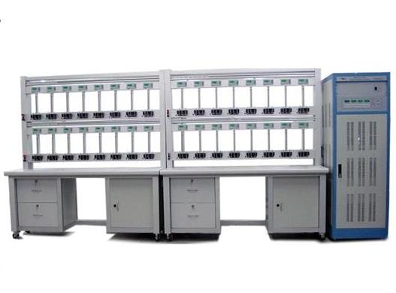
Phantom machine
It is the place where meters are tested and it is the holding stand of testing meters.

Slide 20
Testing of meters
Starting meter test :-
0.4% current – 20 PF – 240 volt – pulse required
Crip test :-
0.4% current – 20 PF – 240 volt – No pulse
Repeatability test :-
Tested by computer

Slide 21
Testing of meters
Power loss :-
7/8 watts
High voltage :-
4kv
Dial test :-
3200 pulse, 1000 watts, 240 volt
Extract value – 0.1

